Slide 1


^{Experimental Activities in} ^{Berkeley}
Andrew S. Voyles
14 November 2016
Nuclear Data Week 2016 - CSEWG

Slide 2
Overview
Berkeley is currently leading a targeted experimental campaign to address these needs:
(n,p) production cross sections – UCB
Stacked-target charged particle excitation functions - LBNL
Tunable broad-spectrum neutron source – LBNL
Nuclear structure
⁵⁶Fe level scheme / lifetimes – GRETINA @ ANL

Slide 3
⁶⁴Cu and ⁴⁷Sc (n,p) Cross-Section Measurements for Medical Radionuclide Production
___________________________
^{UCB}

Slide 4
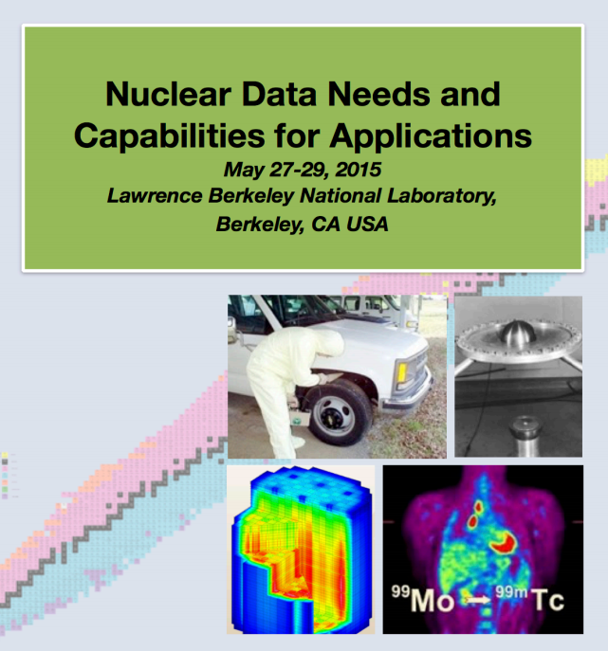
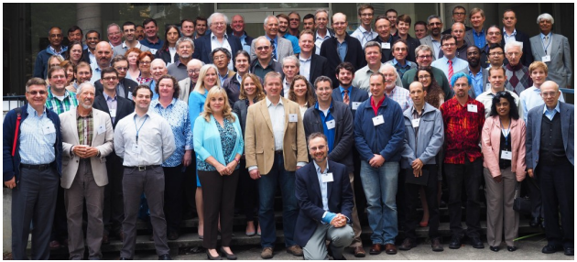
Some perspective
Notes:
Dr Qaim - plenary speaker and instigator of priority isotopes

Slide 5
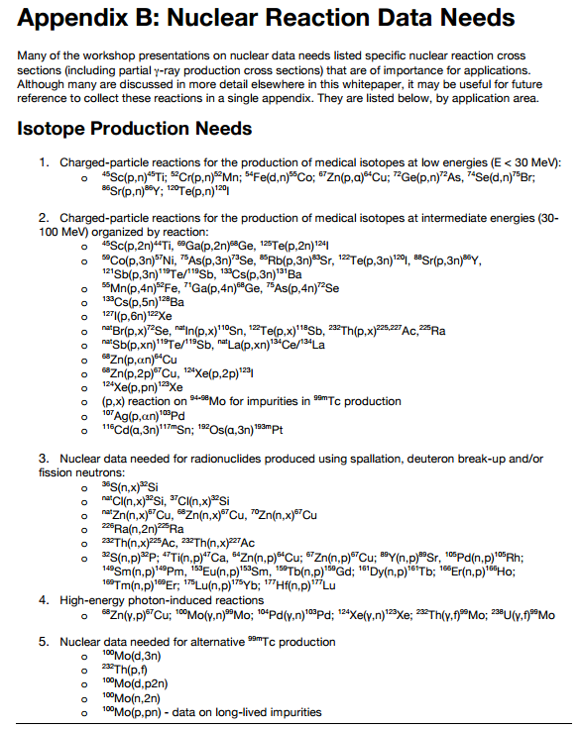
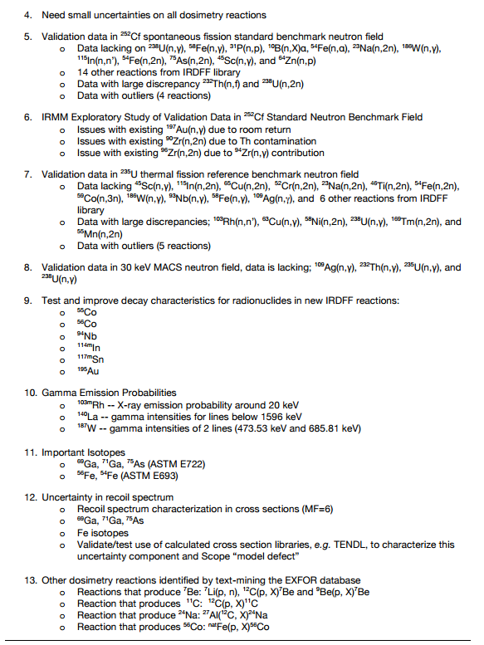
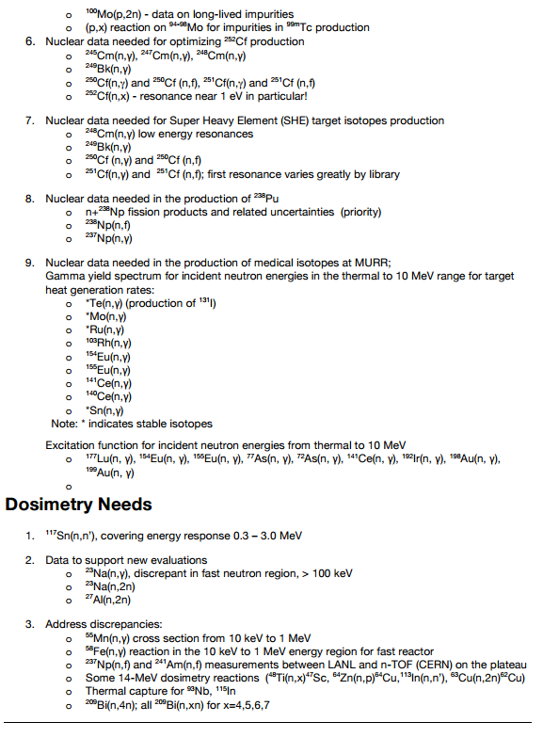
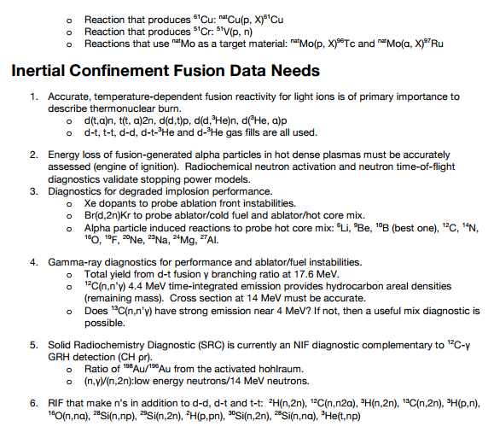
Some perspective
Highlight from WTTC 2016: ⁵⁴Fe(p,α)⁵¹Mn
NDNCA Whitepaper available at http://bang.berkeley.edu/events/ndnca/whitepaper/

Slide 6
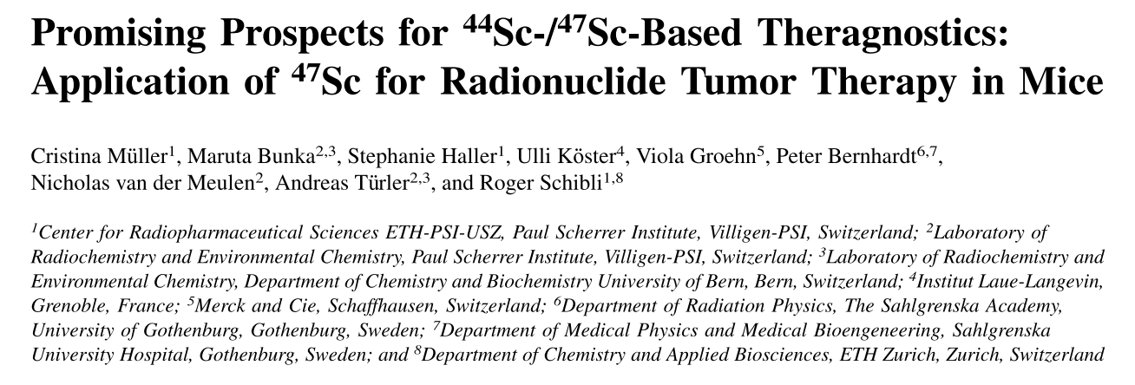
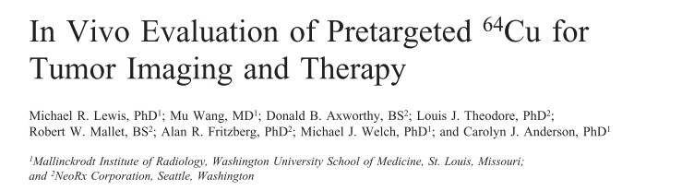
Medical Applications
Emerging medical radionuclides
⁶⁴Cu (t_{1/2} = 12.7 hr) – 61% β⁺ to ⁶⁴Ni, 39% β⁻ to ⁶⁴Zn
⁴⁷Sc (t_{1/2} = 3.35 d) – β⁻ to ⁴⁷Ti, with 159-keV γ

Slide 7
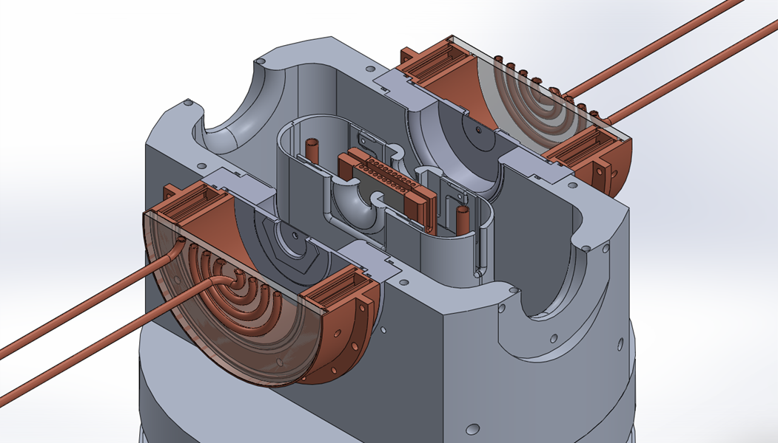
The UC Berkeley High Flux Neutron Generator
2.45 MeV neutrons, 10⁸ n/s/cm²
Extraction Plate: 5mm diameter
Commissioning:
25 July 2015
D Plasma
100kV
RF
DD Fusion
D beam
1-1000mA
Deuterium Gas
H₂O

Slide 8
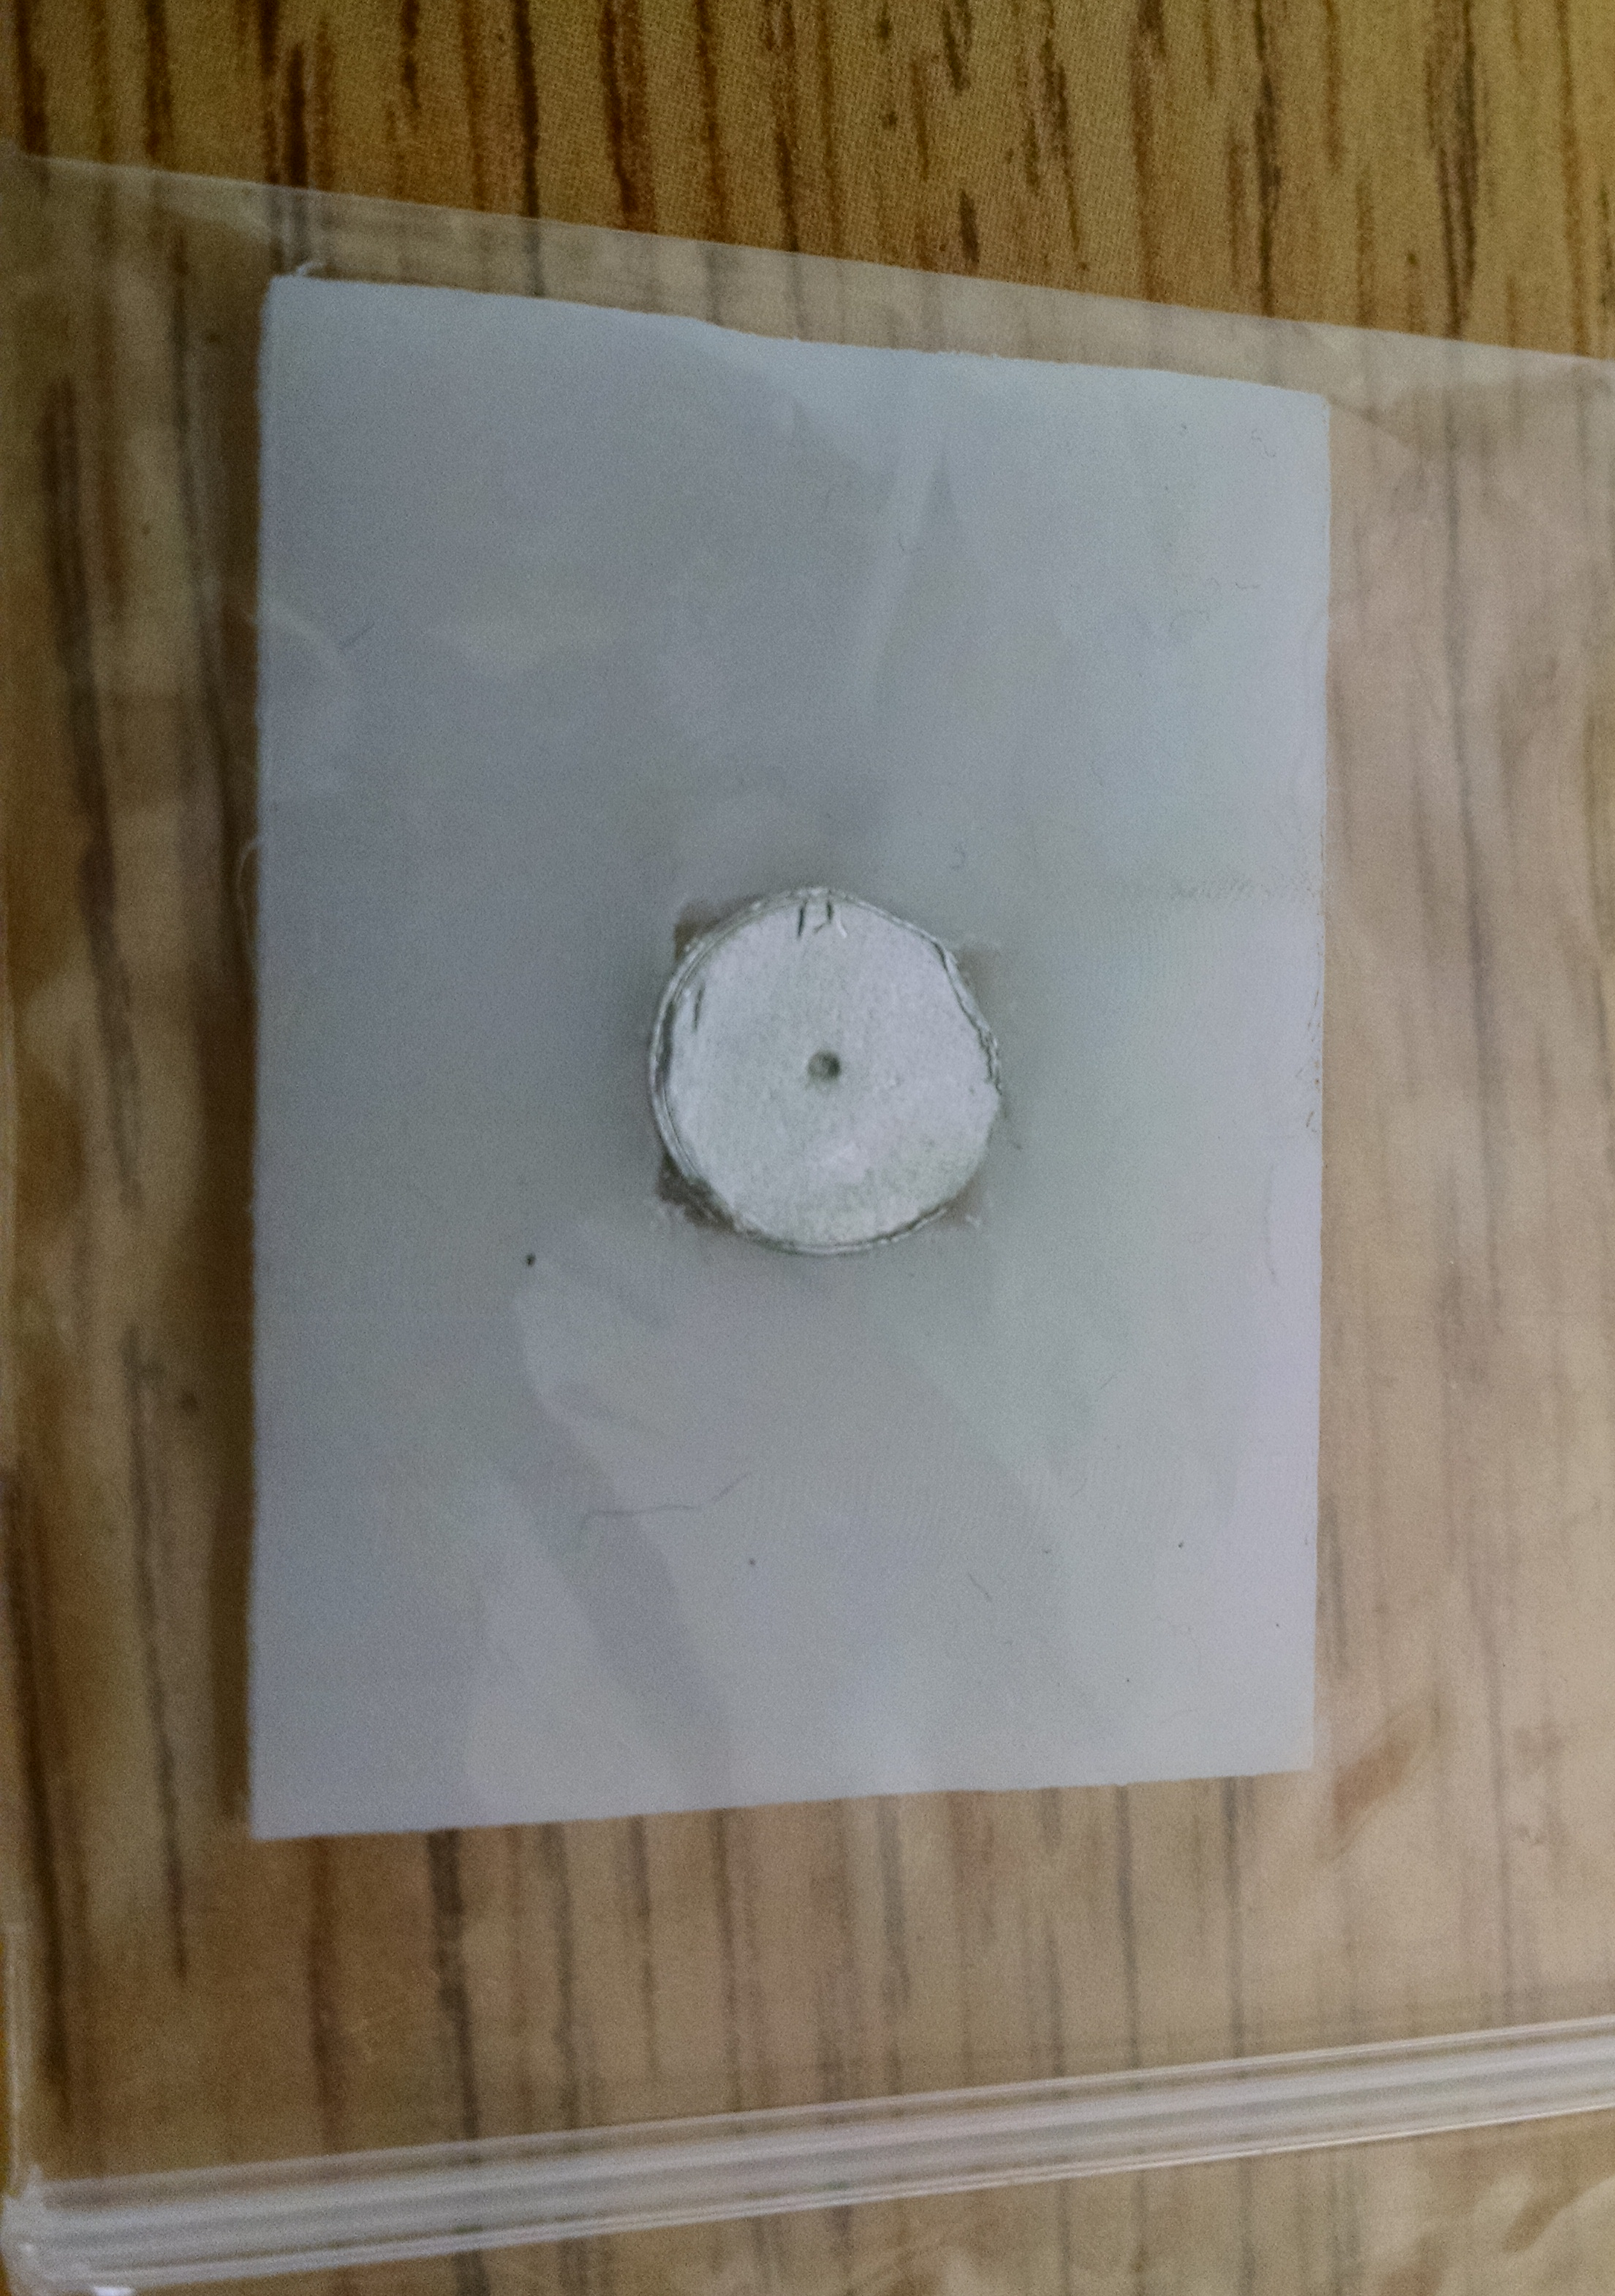
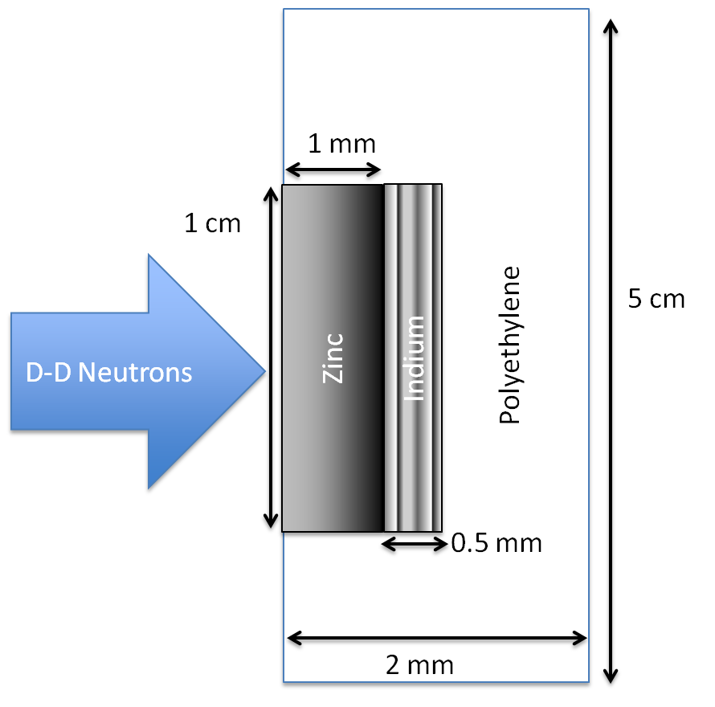
The UC Berkeley High Flux Neutron Generator
Foils Used | Metal Purity | Abundance (a/o) | Foil Density (mg/cm²)
^{nat}In | > 99.999% | ¹¹³In (4.29%), ¹¹⁵In (95.71%) | 365.5
^{nat}Zn | > 99.99% | ⁶⁴Zn (49.17%) | 714.1
^{nat}Ti | 99.999% | ⁴⁷Ti (7.44%) | 450.6
Notes:
64Zn - 49.17%, 66Zn – 27.73%, 67Zn – 4.04%, 68Zn – 18.45%
46Ti – 8.25%, 47Ti – 7.44%, 48Ti – 73.72%, 49Ti – 5.41%, 50Ti – 5.18%

Slide 9
The UC Berkeley High Flux Neutron Generator
Zn
Zn
In
In

Slide 10
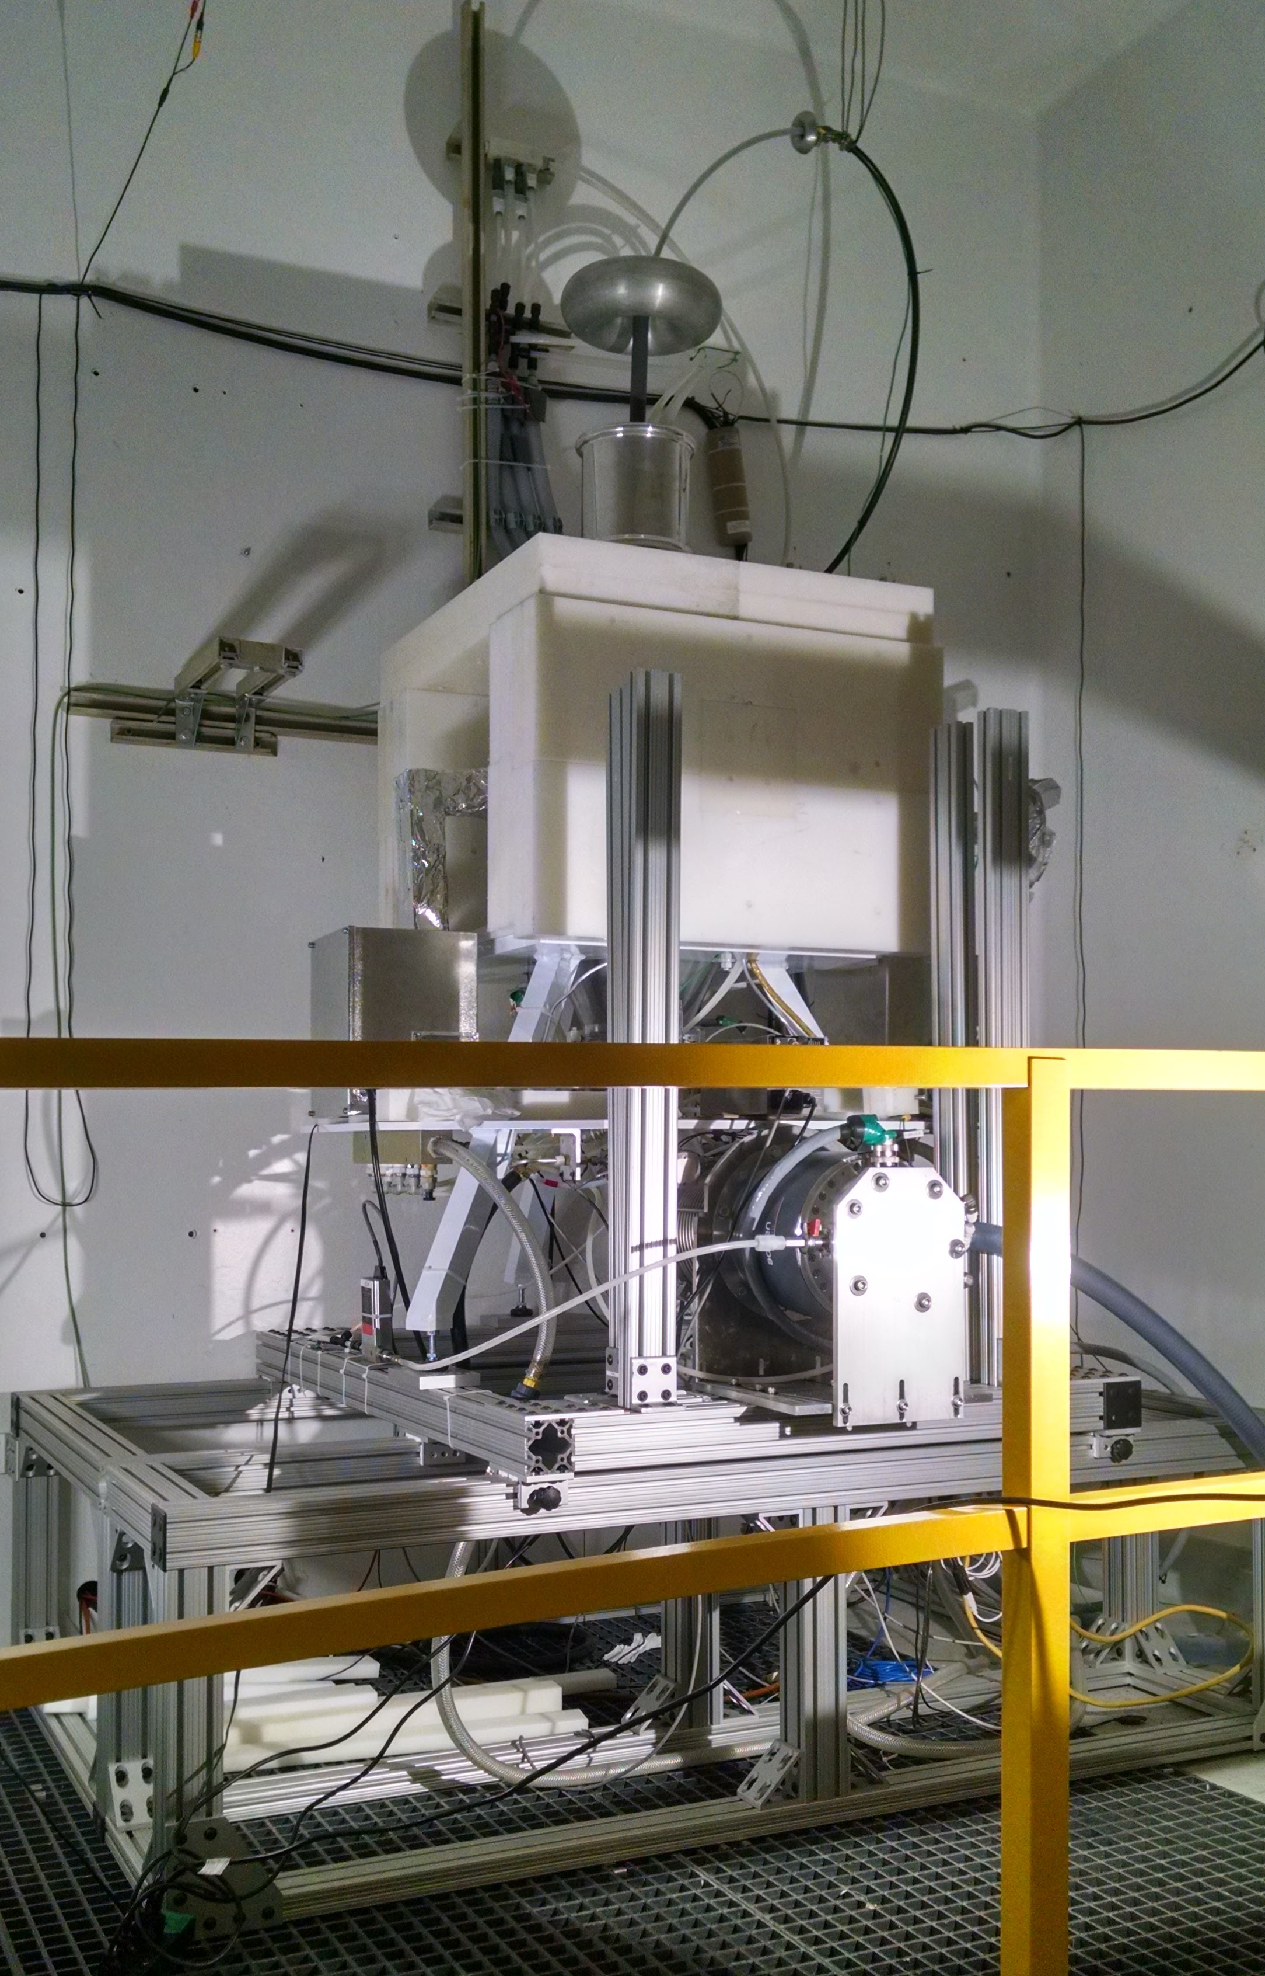
The UC Berkeley High Flux Neutron Generator
Zn
In

Slide 11
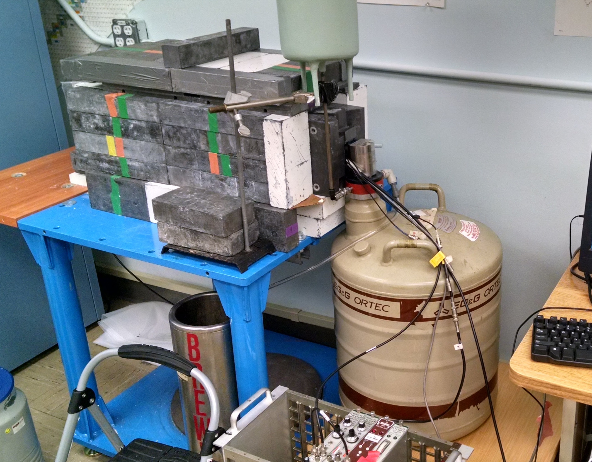
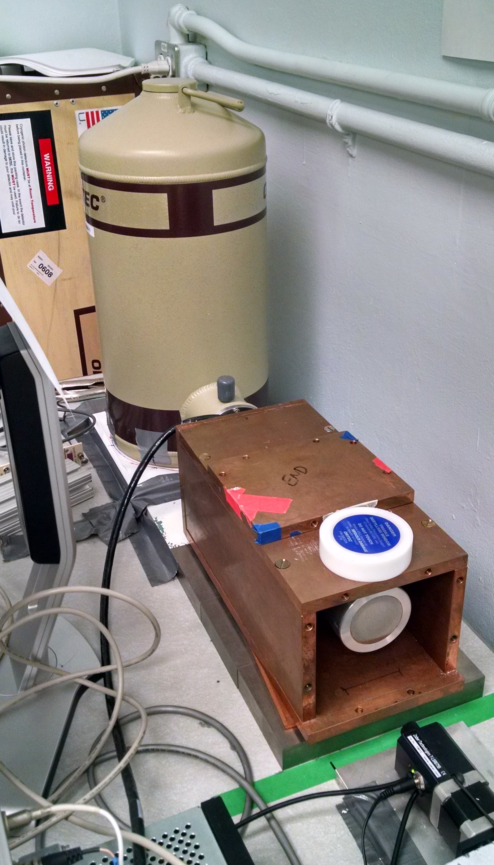
Relative Activation Measurements
Ortec Planar LEPS detector
Ortec 80% HPGe detector

Slide 12
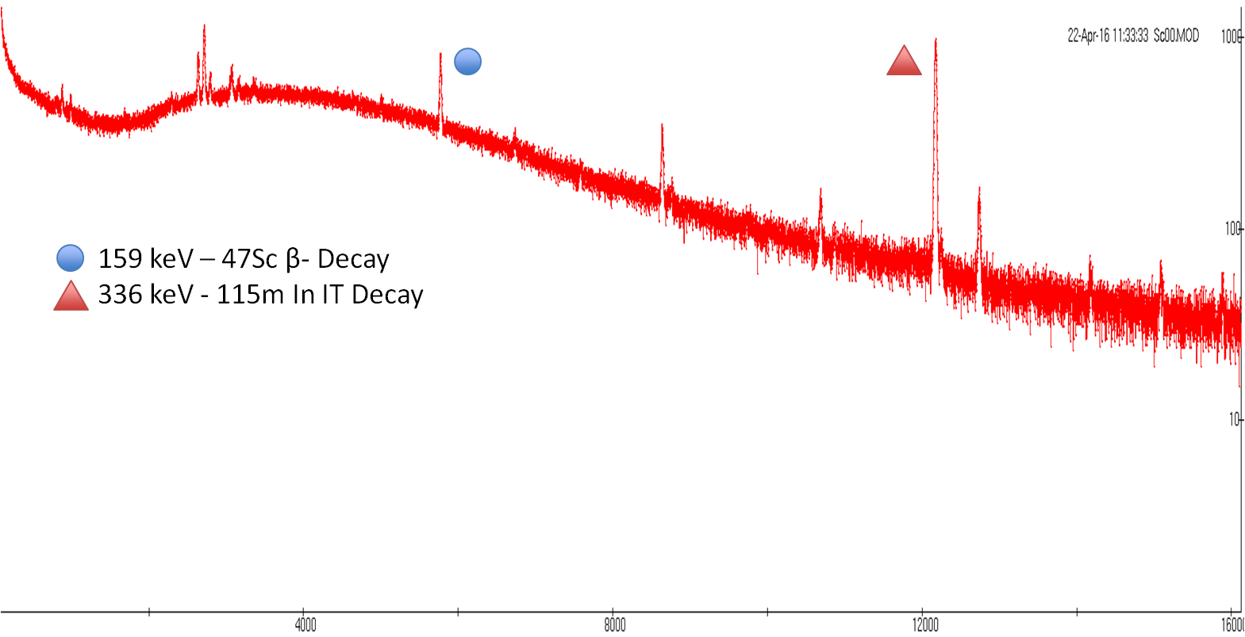
Relative Activation Measurements
336 keV - 115m In IT Decay
391 keV - 113m In IT Decay
417 keV - 116 In β- Decay
511 keV - 64 Cu β+ Decay

Slide 13
Relative Activation Measurements
t_{1/2} = 12.097 ± 0.8348 h
(ENSDF = 12.701 h)
χ² /ν = 1.743
t_{1/2} = 4.519 ± 0.044 h
(ENSDF = 4.486 h)
χ² /ν = 1.656
336 keV - 115m In IT Decay
391 keV - 113m In IT Decay
417 keV - 116 In β- Decay
511 keV - 64 Cu β+ Decay
Notes:
Producing O(10 kBq), with dead time < 5%

Slide 14
Relative Activation Measurements
What’s going on???

Slide 15
Neutron Energy Spread
n
n
θ
n
Titanium
d
D
n

Slide 16
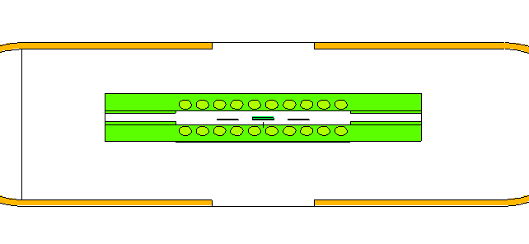
Neutron Energy Spread
Neutron Energy Spread
H. Liskien et al., Nucl Data Tables, vol 11, 2973
Neutron flux profile modeled in target and monitor foil, using MCNP6

Slide 17
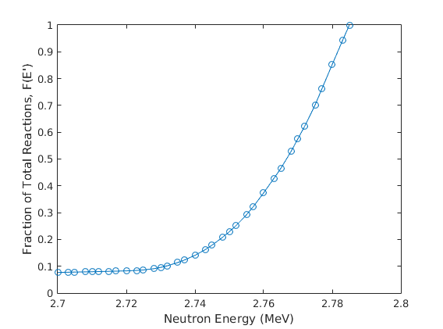
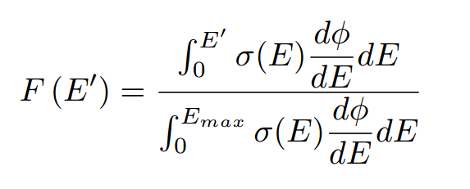
Neutron Energy Spread
Neutron Energy Spread
H. Liskien et al., Nucl Data Tables, vol 11, 2973
Neutron flux profile modeled in target and monitor foil, using MCNP6
-σ_{<E>}
<E>
+σ_{<E>}
E_{max} = Maximum energy neutron subtended by foil
F(E’) = Fraction of Total Reactions induced up to energy E’

Slide 18
Neutron Energy Spread
⁶⁴Zn(n,p)⁶⁴Cu
Before…
⁴⁷Ti(n,p)⁴⁷Sc

Slide 19
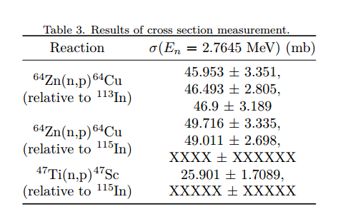
Neutron Energy Spread
⁶⁴Zn(n,p)⁶⁴Cu
After!
⁴⁷Ti(n,p)⁴⁷Sc

Slide 20
Neutron Energy Spread
⁶⁴Zn(n,p)⁶⁴Cu
After!
⁴⁷Ti(n,p)⁴⁷Sc

Slide 21
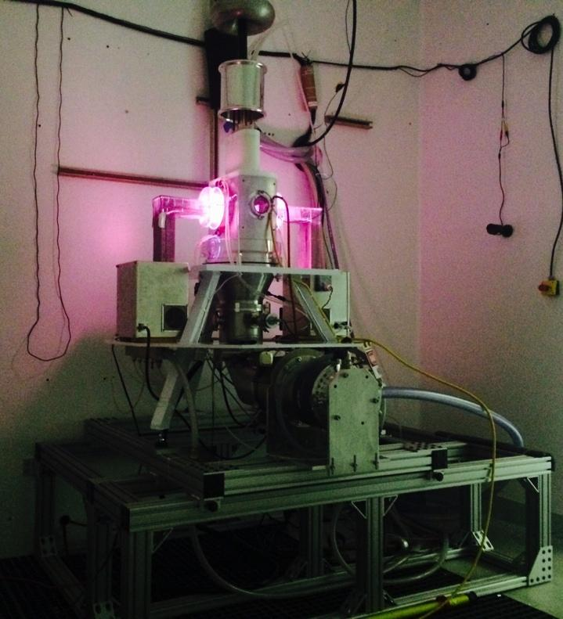
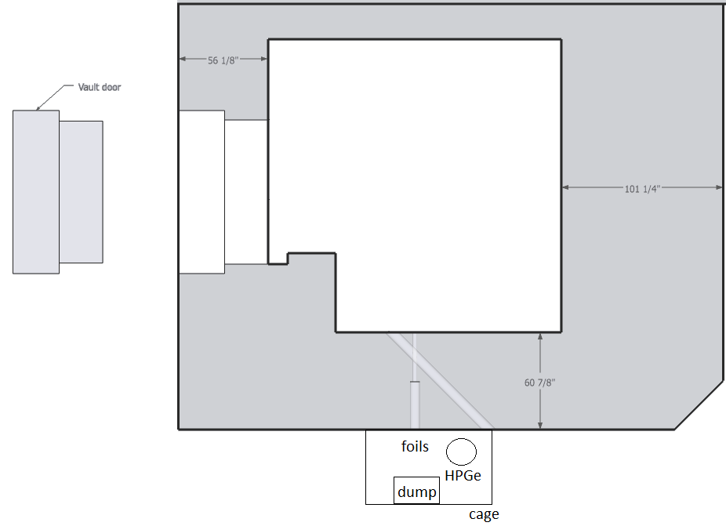
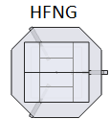
Future Work
Internal:
10⁸ n/s/cm²
Phase 1 current upgrade complete!
Target | Nuclide | Threshold (keV) | % abundance | Strongest γ-ray branch (keV) | # seen in a 0.5% Ge detector | Rate in a 0.5% detector
32S | 32P | 985 | 95% | 0 | 0.00E+00 | 0.00
47Ti | 47Ti | 0 | 7.44% | 159.381 | 1.24E+05 | 1.44
64Zn | 64Cu | 0 | 49.20% | 511 | 5.03E+05 | 5.82
67Zn | 67Cu | 0 | 4.04% | 184.577 | 5.45E+04 | 0.63
89Y | 89Sr | 726 | 100% | 908.96 | 1.25E+02 | 0.00
105Pd | 105Rh | 0 | 22.33% | 318.9 | 1.27E+05 | 1.47
149Sm | 149Pm | 291 | 11.24% | 285.94 | 4.47E+03 | 0.05
153Eu | 153Sm | 25 | 52.19% | 103.18 | 1.36E+05 | 1.58
159Tb | 159Gd | 190 | 100% | 363.543 | 1.58E+05 | 1.83
161Dy | 161Tb | 0 | 18.89% | 75.57 | 2.66E+04 | 0.31
166Er | 166Ho | 1079 | 33.50% | 1379.4 | 4.39E+03 | 0.05
169Tm | 169Er | 0 | 100% | 109.8 | 1.87E+01 | 0.00
175Lu | 175Yb | 0 | 97.40% | 396.3 | 1.88E+05 | 2.18
177Hf | 177Lu | 0 | 18.60% | 208.4 | 3.77E+04 | 0.44
Monoenergetic Beam: 10³⁻⁴ n/s/cm²

Slide 22
Stacked-target Charged Particle Excitation Functions
___________________________
^{LBNL}

Slide 23
BGS

Slide 24
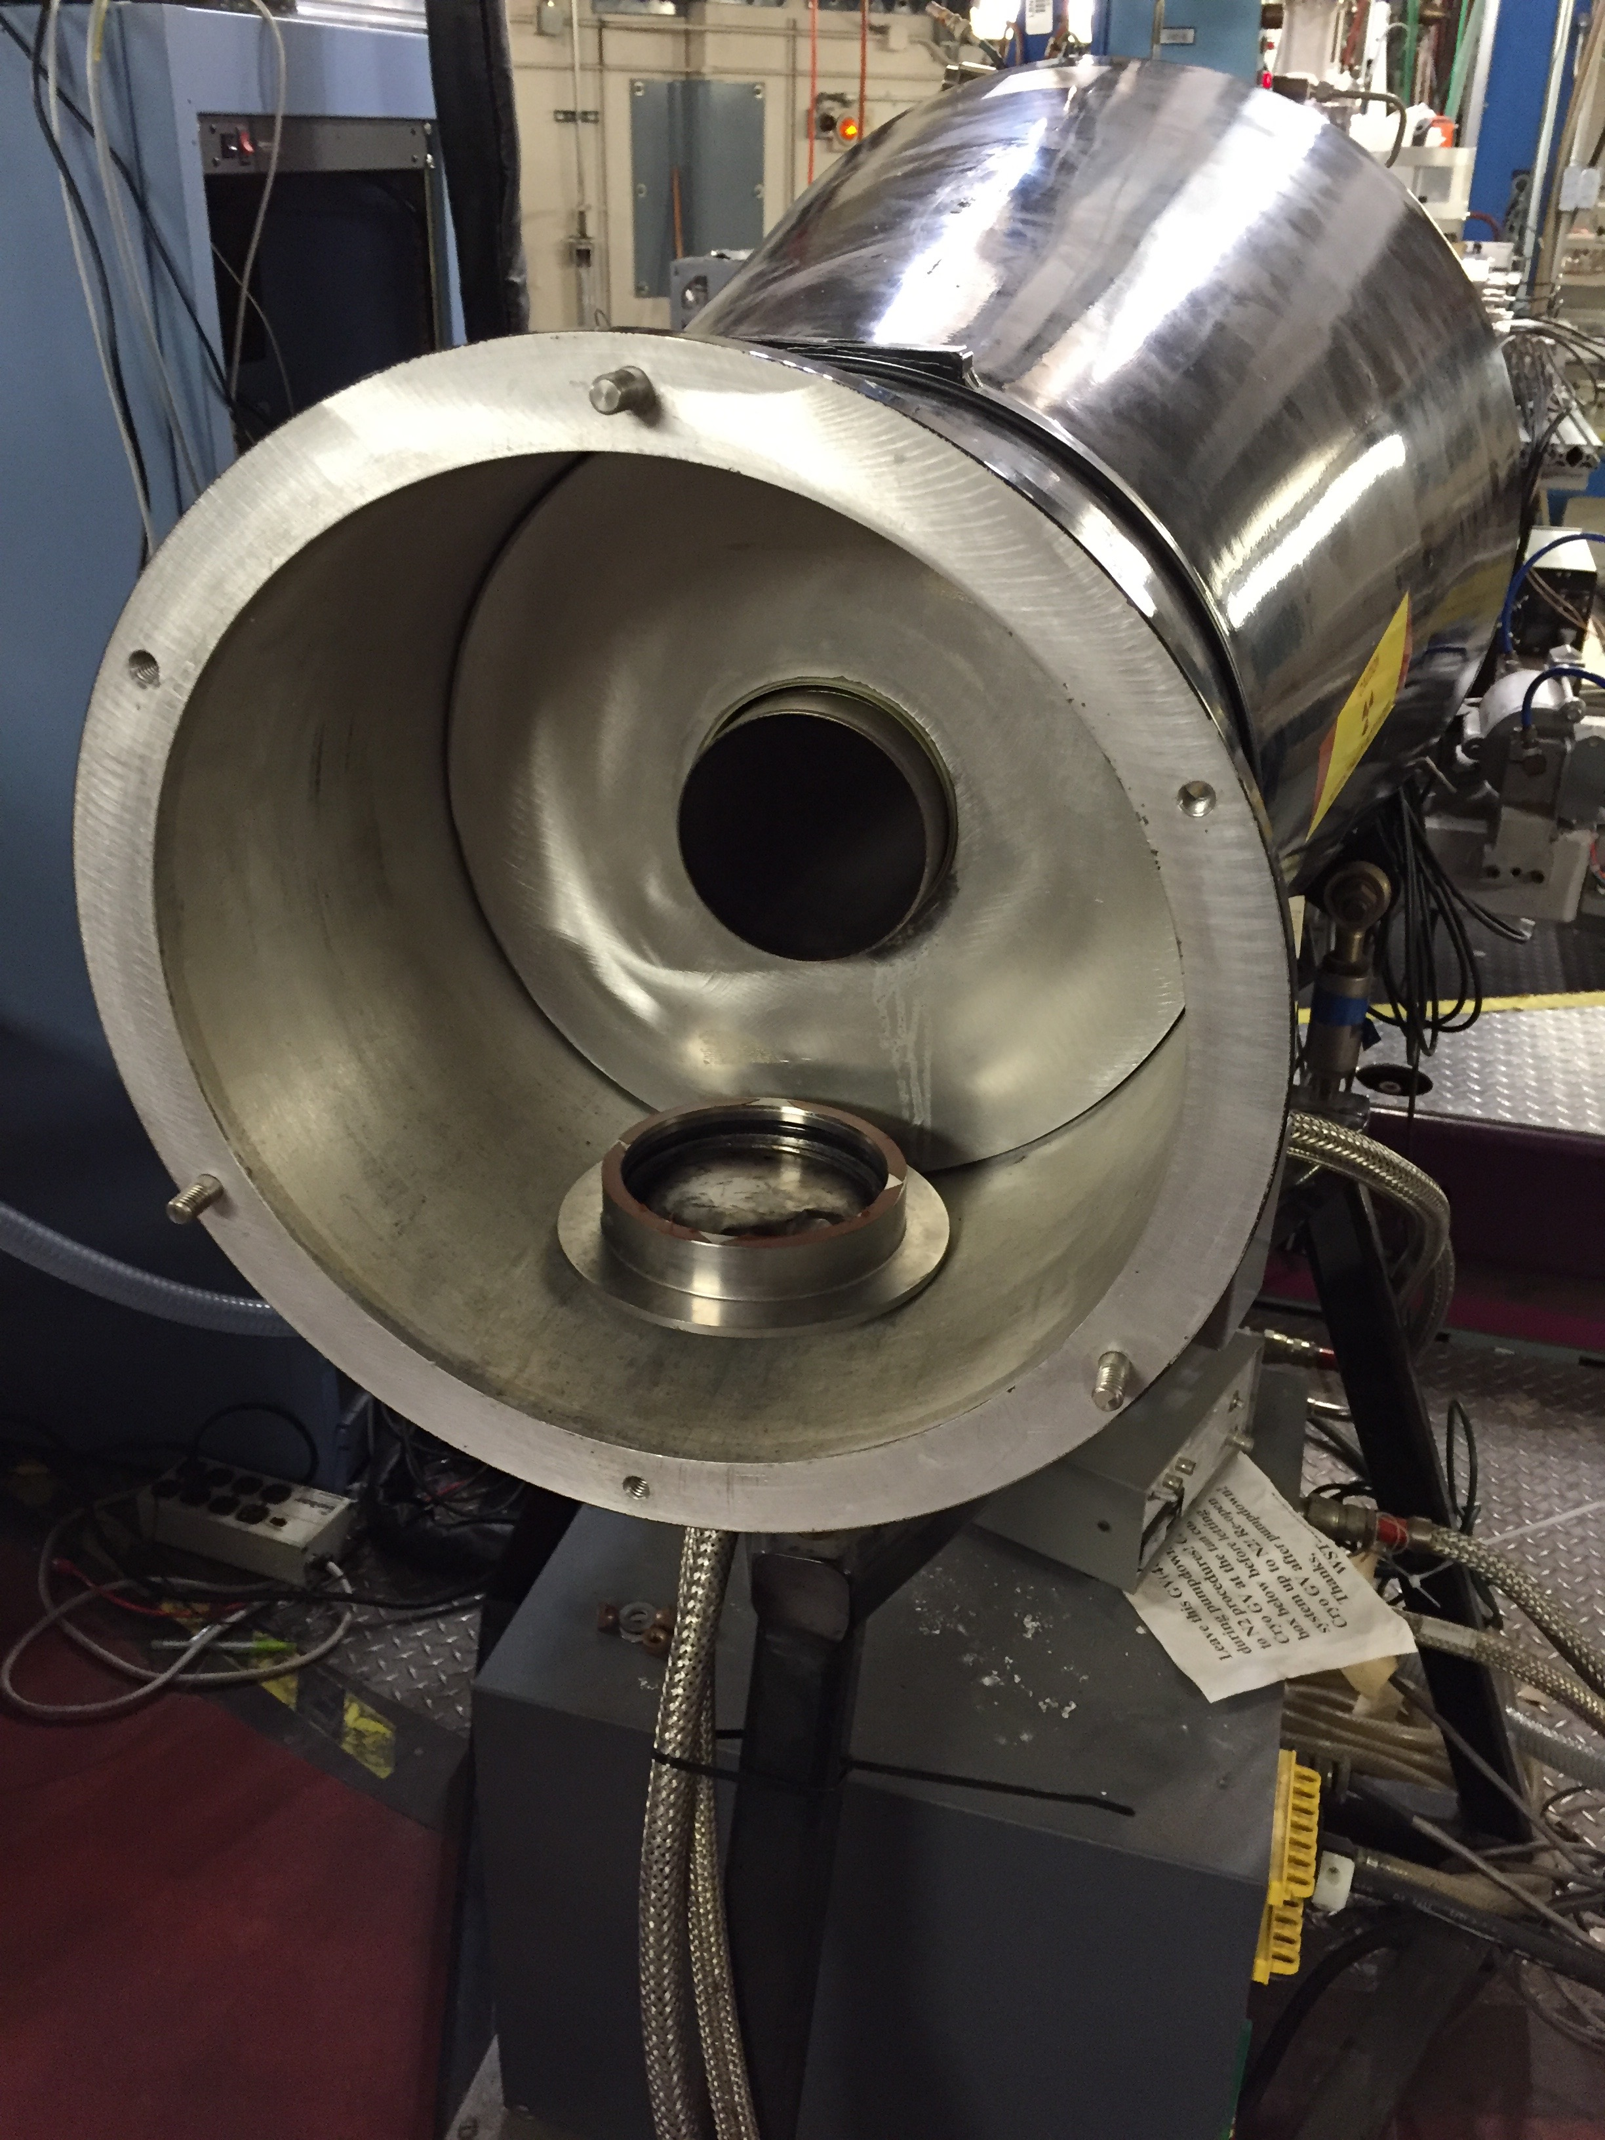
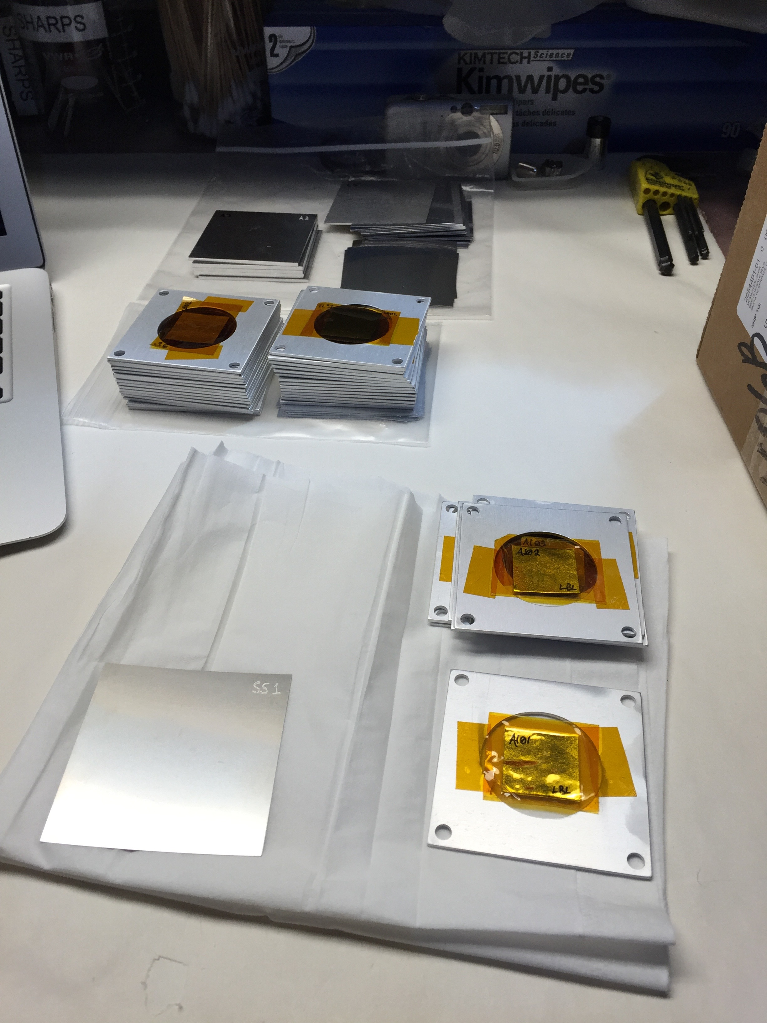
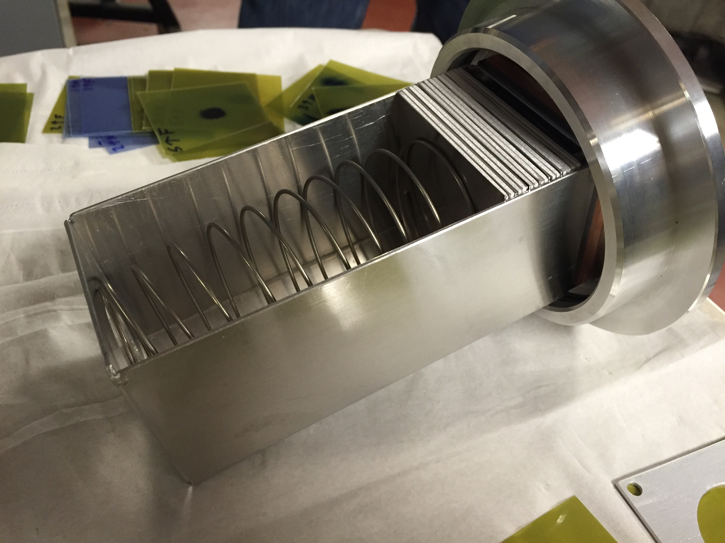
25 μm – thin foils in 0.1” Al frames

Slide 25
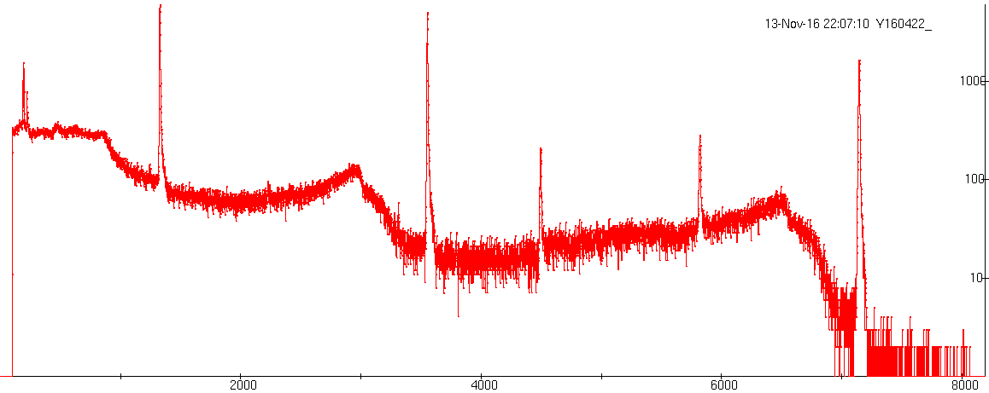
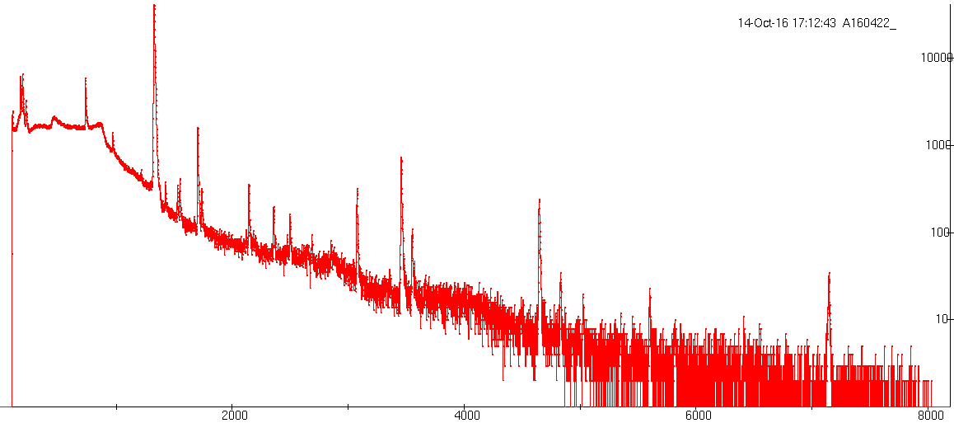
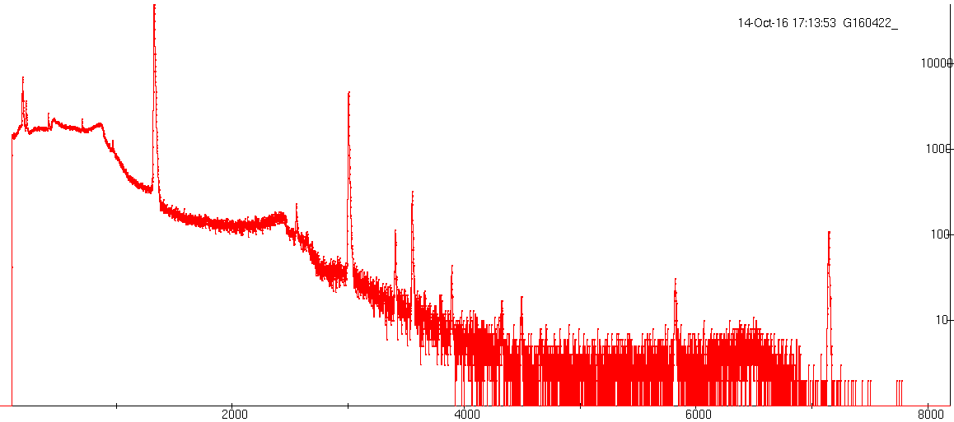
Al Spectra
Cu Spectra
Ti Spectra

Slide 26
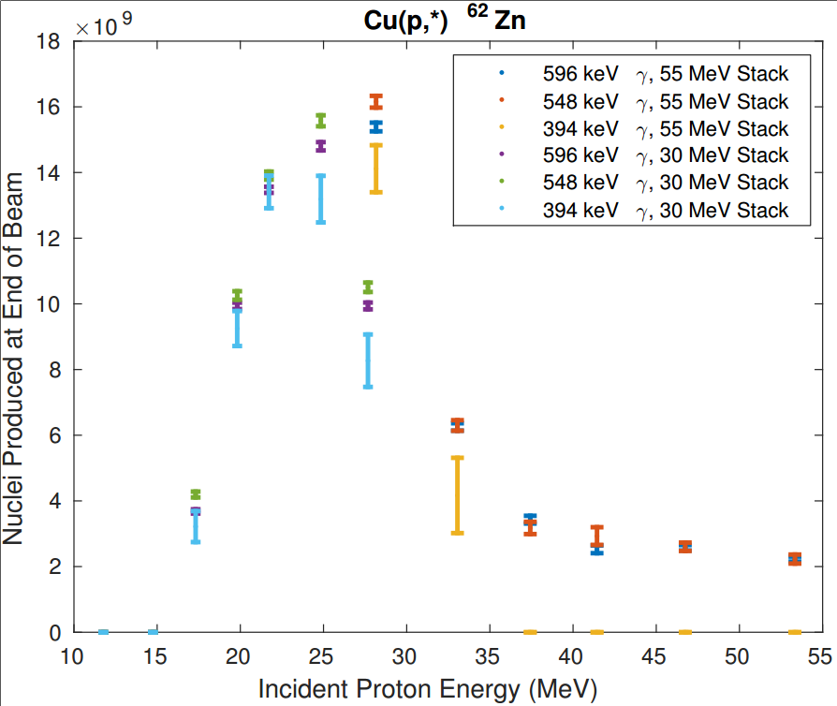
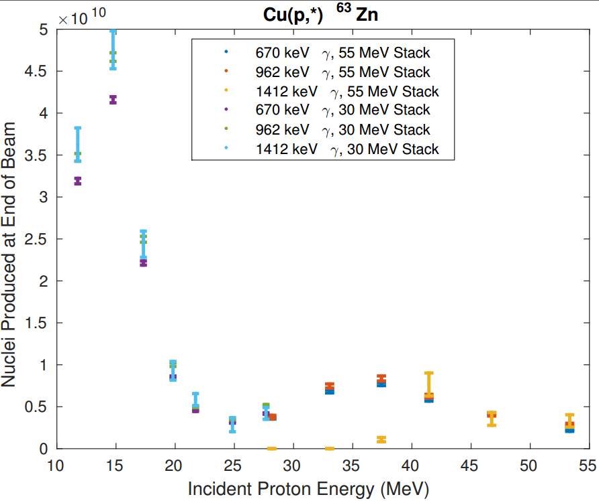
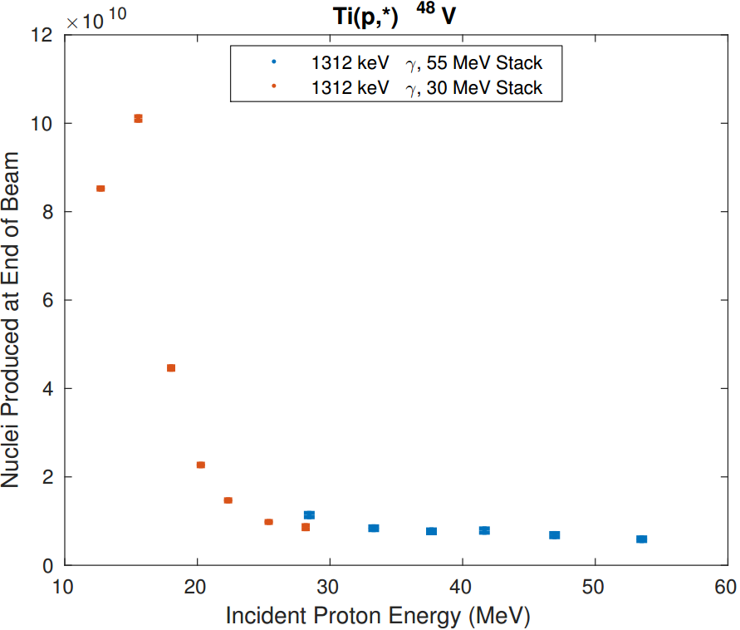
Preliminary results

Slide 27
Tunable Neutron Source
___________________________
^{LBNL}

Slide 28
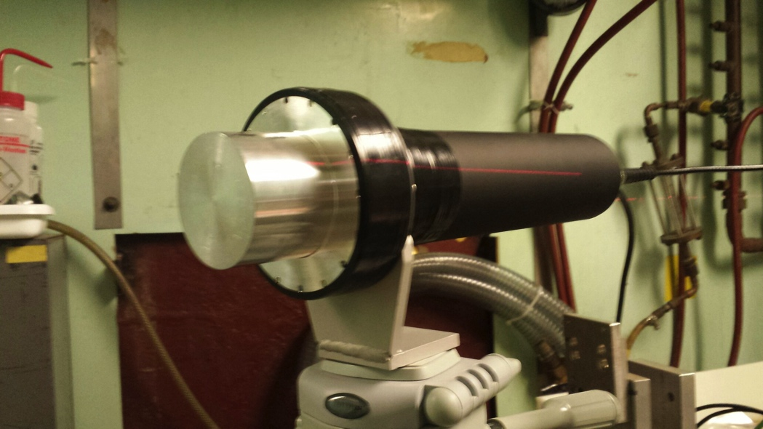
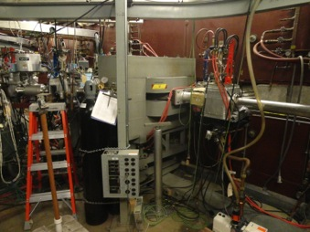
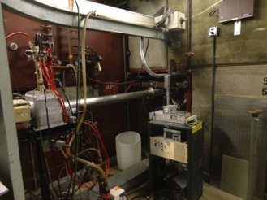
Notes:
The neutrons employed in these measurements were obtained using deuteron breakup at the 88-Inch Cyclotron at Lawrence Berkeley National Laboratory.
A Faraday Cup, housing a 3.8~cm thick tantalum target, located in the cyclotron vault was used for both online beam monitoring and to produce ``breakup" neutrons via the $^{nat}$Ta($^2$H,n) reaction. A portion of these breakup neutrons passed through 3~m of concrete and 1.5~m of sand bags encasing a beam pipe, forming a 10-cm-radius, well-collimated, open-air neutron beam that was used in the experimental area.

Slide 29
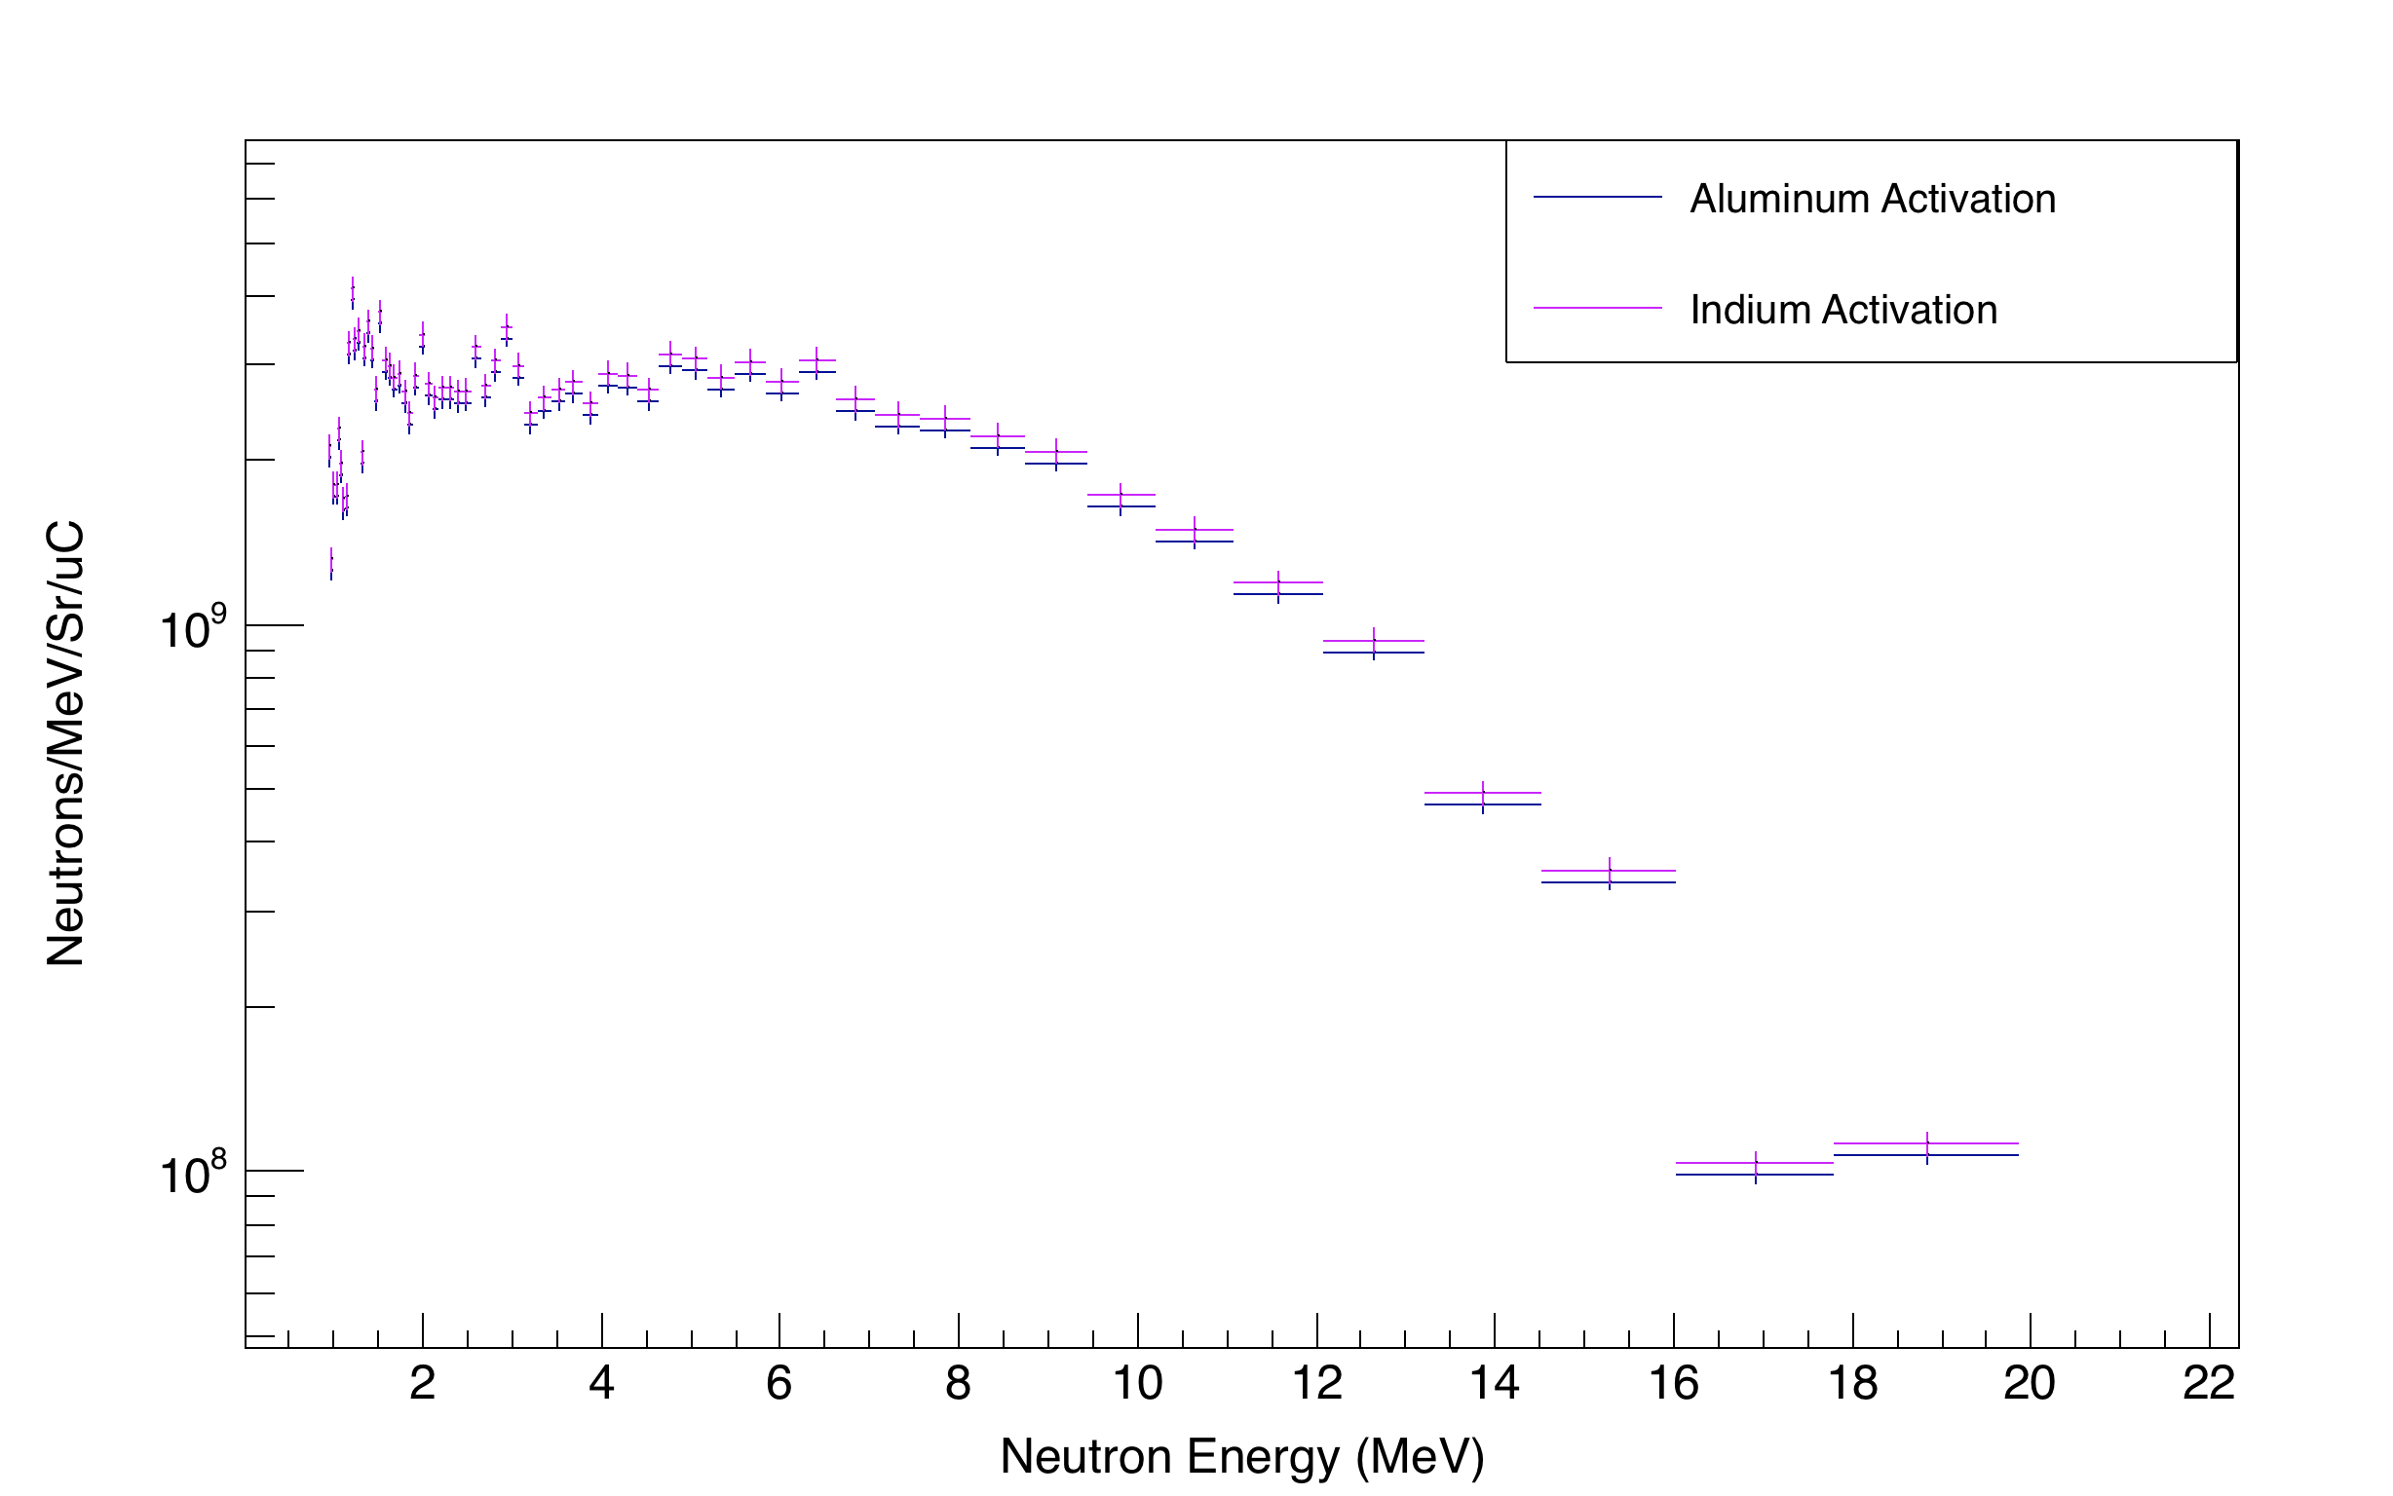
10-cm-radius, well-collimated, open-air neutron beam
E_{d} = 16 MeV
Preliminary
K.P. Harrig, J.A. Brown, D.L. Bleuel, B.L. Goldblum, L.A. Bernstein, E.F. Matthews, T. Laplace:
Bay Area Neutron Group
Notes:
96 uA max limit @ 16 MeV D

Slide 30
⁵⁶Fe Structure
___________________________
^{GRETINA @ ANL}

Slide 31
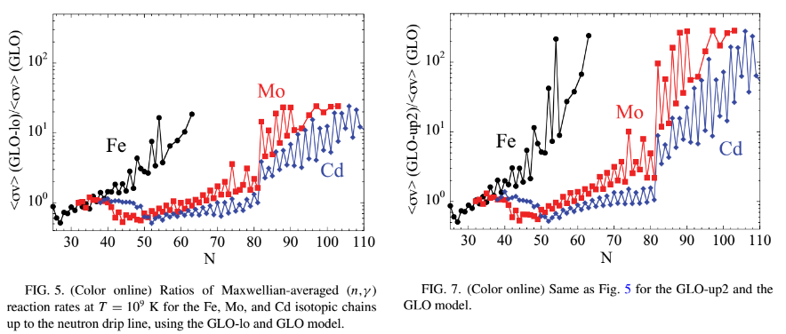
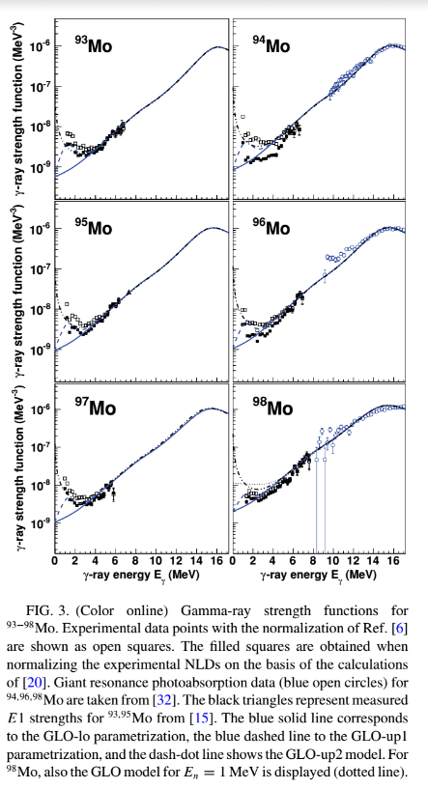
Larsen et al, DOI: 10.1103/PhysRevC.82.014318
Notes:
Low-energy upbend and consequences of upbend

Slide 32

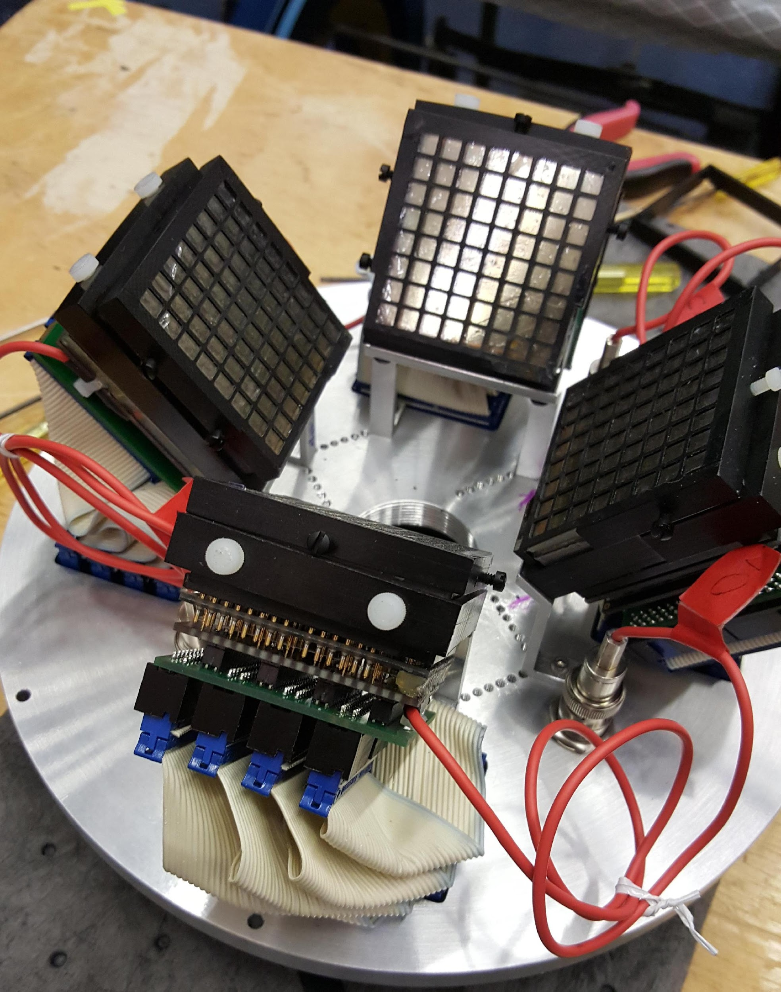
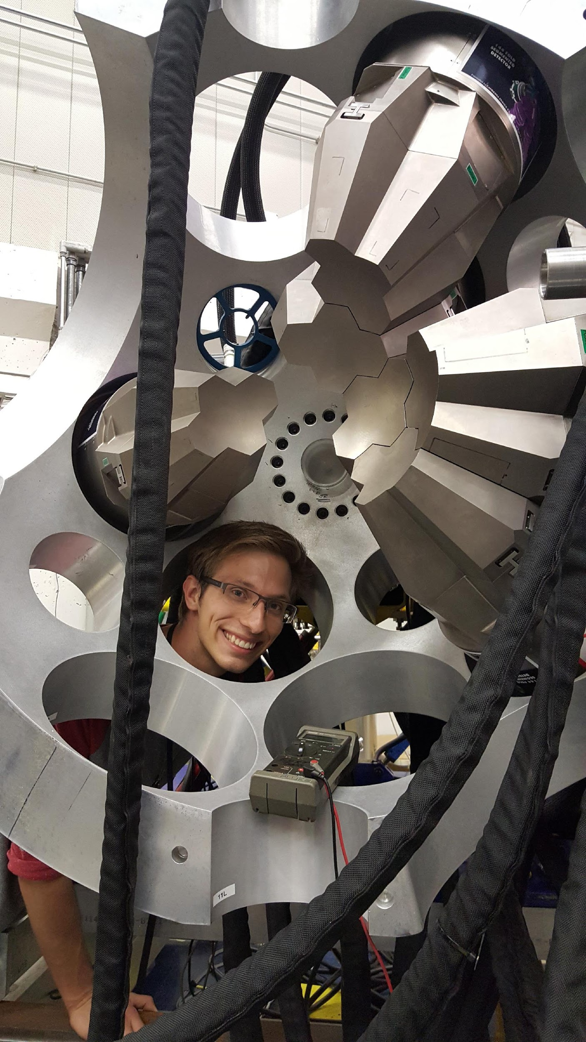
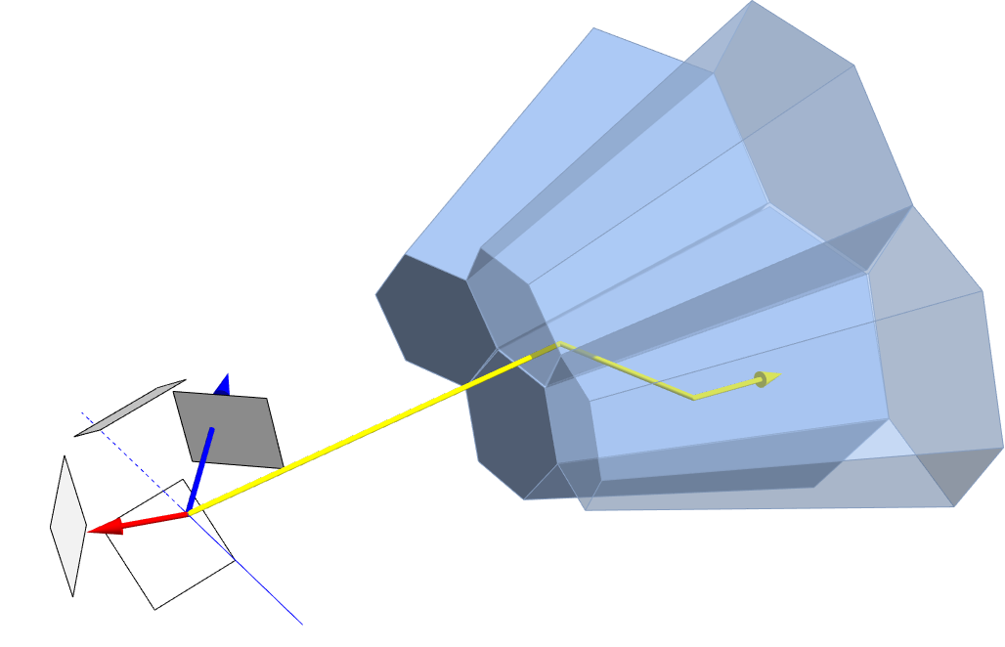
Leo Kirsch
UC Berkeley
4th year PhD student
LBNL GRETINA Team
⁵⁶Fe(p,p'ɤ) @ Argonne
Level Scheme
Low lying lifetimes
Phoswich Wall:
E_{p}, θ_{p}
p'
ɤ
⁵⁶Fe
GRETINA: E_{ɤ}, θ_{ɤ}
p_{i}
Notes:
Can use GRETINA to obtain structure data to understand this upbend!
16 MeV proton inelastic scattering on 56Fe. 6 days of beam in June 2015.
Top Middle: Phoswich Wall Particle Detector. Designed for inverse kinematic reactions, repurposed for normal kinematics in this experiment.
Right: Leo dismantling GRETINA after experimental campaign completion at Argonne.
Bottom: Illustration of the reaction: Incident proton (blue) inelastically scatters into Phoswich Wall (white) causing excited 56Fe (red) to recoil and emit gamma ray (yellow) detected by GRETINA.
Phoswich detects angle and energy of proton. GRETINA detects angle and energy of gamma.

Slide 33
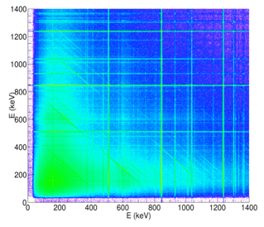
⁵⁶Fe(p,p’γ) Level Scheme (partial)
Tracked
γ−γ data
Notes:
Improve nuclear structure = improved level scheme
Top left: current knowledge of the cumulative levels of 56Fe. Continuum measurements from Oslo Cyclotron Lab show missing levels in ENSDF above 5.5 MeV, well below the proton and neutron separation energies.
Bottom: background subtracted data (red) coincident with known 1670 gamma ray from level 3389 keV. Low energy gamma coincidences confirmed. New gammas emerge from unmeasured levels 5.5 MeV and above. Theses levels emerge right where the ENSDF data shows a deficit compared to Oslo.
Right: Partial level scheme of 56Fe. The 1670 gate for bottom plot highlighted in red, new levels from bottom plot highlighted in blue. More new gammas and levels coincident with 1303 gamma highlighted in pink. Data for the 1303 coincidence not shown. Spins and parities of new levels undetermined.

Slide 34
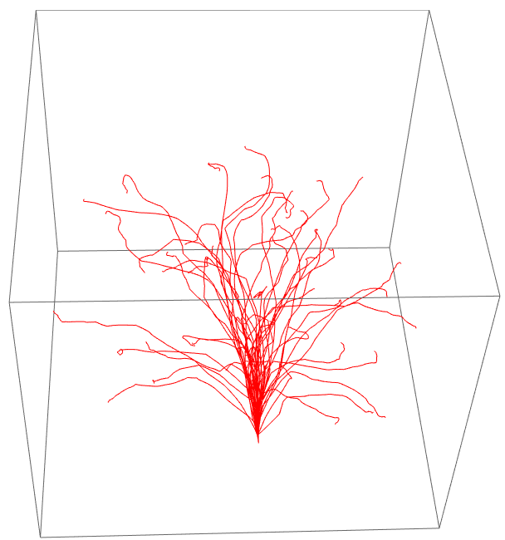
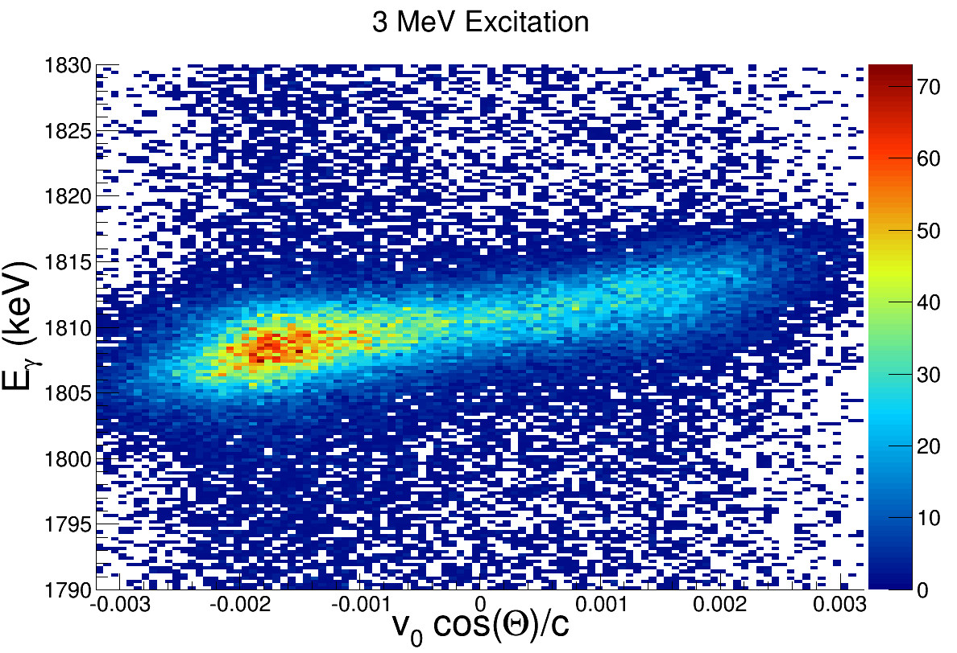
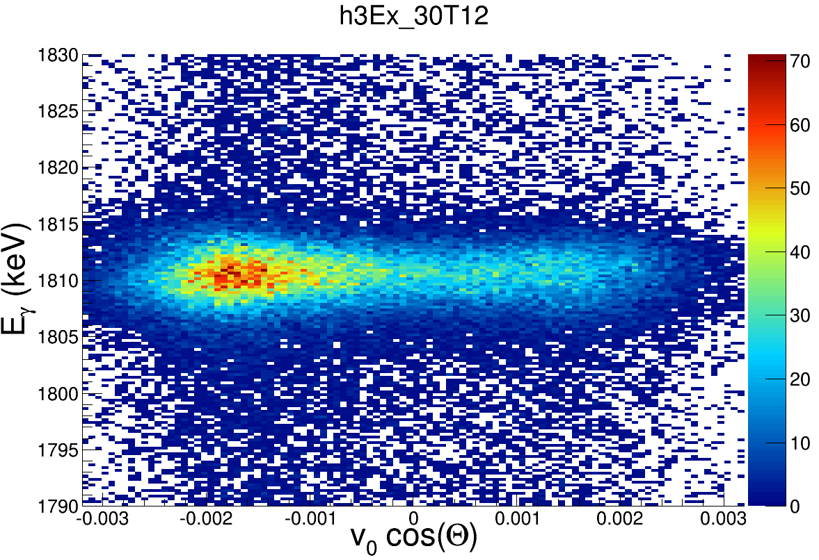
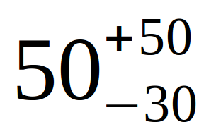
Doppler Shift
⁵⁶Fe 2⁺₂ → 2⁺₁
Recoil Simulation
Recoil toward
emission: high E_{ɤ}
Recoil away from
emission: low E_{ɤ}
counts
⁵⁶Fe
p'
After t_{1/2}=30 fs correction
This
Work
ENSDF
Comparison
Lvl(keV) E_{γ}(keV) Transition t_{1/2} (fs) (n,n') (p,p')
2657 1810 2⁺₂→ 2⁺₁ 33(2) 21(1) 28(7)
2960 2113 2⁺₃→ 2⁺₁ 20(4) 28(3) 27(9)
3120 2273 1⁺₁→ 2⁺₁ 20(8) 19(1) 24(11)
3123 1037 4⁺₂→ 4⁺₁ 51(4) 47(12)
3370 2523 2⁺₄→ 2⁺₁ 19(2) 17(3) 18(7)
3445 2598 3⁺₁→ 2⁺₁ <52 29(5) <28
counts
Outgoing particle
not observed
Notes:
Can use GRETINA for precise lifetime measurements!
Top Left: Doppler shifted data of the 2+2 → 2+1 transistion of 56Fe. The x-axis is the initial recoil velocity of 56Fe in the direction of the detector that observes the gamma ray energy on the y-axis. Color axis is number of counts. 56Fe moving away from gamma emission direction have gamma energy ~5keV less energy than 56Fe moving toward gamma emission direction.
Top Right: 56Fe recoil simulations with SRIM. Used to apply an average correction on an event by event basis to flatten the doppler shift. Simulation based on one parameter: t_{1/2} of the level.
Bottom Left: data after lifetime correction. Error on lifetime comes from how well residual slope can be measured.
Bottom Right: Results from this work compared to ENSDF. Partial agreement with certain levels, discrepancies arise from the fact that (n,n') measurements do not observe outgoing particle and need to model reaction as well as recoil slowing down.

Slide 35
Acknowledgements
This work has been carried out at the University of California, Berkeley, and performed under the auspices of the U.S. Department of Energy by Lawrence Livermore National Laboratory under contract DE-AC52-07NA27344 and Lawrence Berkeley National Laboratory under contract # DE-AC02-05CH11231. Funding has been provided from the US Nuclear Regulatory Commission and the US Nuclear Data Program.
M.S. Basunia, J.C. Batchelder, J.D. Bauer, L.A. Bernstein, D.L. Bleuel, J.A. Brown, B.L. Goldblum, K.P. Harrig, L. Kirsch, T. Laplace, E.F. Matthews, M.A. Unzueta, A.S. Voyles

Slide 36

Thanks!

